Slide 1
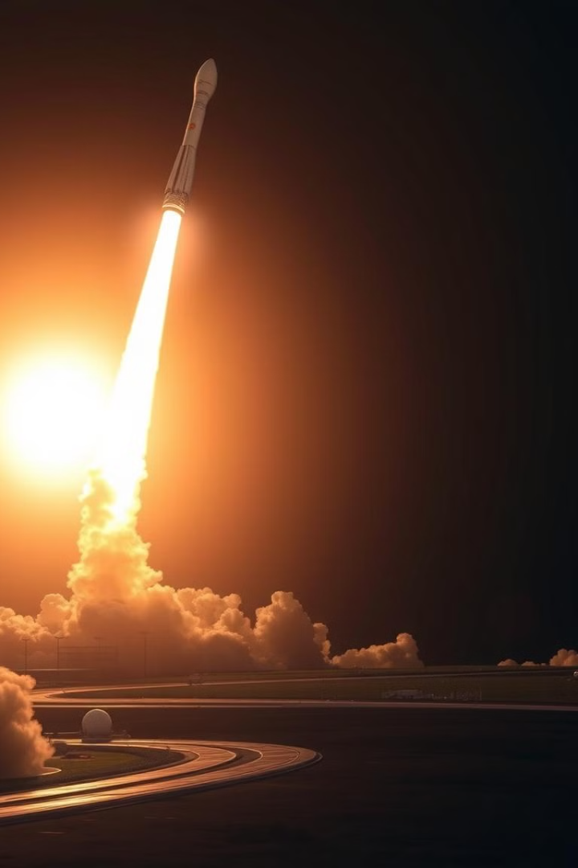
SpaceX Launch Data Analysis & Prediction
This presentation delves into the intricacies of SpaceX launch data, offering a comprehensive analysis of mission successes, influential factors, and predictive modeling outcomes. We aim to provide actionable insights for understanding and optimizing commercial spaceflight operations. Our analysis utilizes a blend of data science techniques, interactive visualizations, and machine learning models to uncover hidden patterns and predict future landing success. The insights gleaned are crucial for stakeholders seeking to enhance mission reliability and efficiency.
By Sri Sakticharan Nirmal Kumar

Slide 2

Executive Summary
1
Objective
2
Key Findings
Analyze SpaceX launch data to extract insights, visualize patterns, and predict successful landings.
Launch success rates, impact of payload mass, site-wise performance, and predictive modeling outcomes.
3
Methods
4
Tools
Data collection, wrangling, exploratory data analysis (EDA), SQL-based insights, visualization, and machine learning.
Python, Pandas, SQLite, Folium, Plotly Dash, Machine Learning models.

Slide 3
Introduction
Why SpaceX?
Project Goals
Understanding commercial spaceflight success factors. Identifying trends in booster landings and payload efficiency.
Data-driven insights on SpaceX launches. Develop interactive dashboards for better visualization. Build a predictive model for landing success.
SpaceX's innovative approach to space exploration offers invaluable learning opportunities. By analyzing their launch data, we seek to uncover critical success factors in commercial spaceflight. This includes identifying key trends in booster landings and evaluating payload efficiency. The project aims to produce data-driven insights, develop interactive dashboards for visualization, and construct a predictive model for landing success, all contributing to a deeper understanding of space mission dynamics.

Slide 4

Data Collection & Wrangling
Data Sources
SpaceX historical launch data. Web scraping for additional details. Public datasets and manually compiled statistics.
Data Cleaning
Handled missing values in payload and landing data. Converted date-time formats. Standardized column names. Created new features such as landing_class.
Our data acquisition process involved gathering information from diverse sources. This includes SpaceX historical launch data, web scraping for supplementary details, and integrating public datasets with manually compiled statistics. A rigorous data cleaning protocol was applied to manage missing values, standardize date-time formats, and create new features such as landing class. These preprocessing steps were crucial for ensuring the reliability and accuracy of subsequent analyses.

Slide 5


EDA & Interactive Visual Analytics
Exploratory Analysis
Visual Insights
Distribution of successful vs. failed launches. Impact of payload mass on success rate. Most frequent launch sites and booster versions.
Interactive plots showing payload distribution. Scatter plots for payload vs. landing success. Pie charts representing launch site distributions.
Exploratory data analysis (EDA) was conducted to uncover underlying trends and patterns within the SpaceX launch data. We examined the distribution of successful versus failed launches, the impact of payload mass on success rates, and the frequency of launch sites and booster versions. Visual insights were derived through interactive plots showcasing payload distribution, scatter plots for payload versus landing success, and pie charts representing launch site distributions, enhancing our understanding of critical mission parameters.

Slide 6

Predictive Analysis Methodology
1
Machine Learning Approach
Logistic Regression model for classification. Feature selection for predictive accuracy. Model evaluation using accuracy, precision, and recall.
2
Training & Testing
Split data into training and testing sets. Cross-validation applied to prevent overfitting.
Our predictive analysis leveraged a Logistic Regression model for classification, chosen for its interpretability and efficiency. Feature selection techniques were applied to enhance predictive accuracy, and the model was rigorously evaluated using metrics such as accuracy, precision, and recall. The data was partitioned into training and testing sets, and cross-validation techniques were employed to mitigate overfitting, ensuring the robustness and generalizability of the predictive model.

Slide 7



EDA with Visualization Results
Key Graphs & Insights
Findings
Payload mass distribution by launch outcome. Success rate variation across years. Heatmaps showing correlations between features.
Higher payloads have varying success rates. Reused boosters increase success probability.
Our exploratory data analysis, combined with visual representation, yielded crucial insights into the SpaceX launch data. Key graphs included payload mass distribution by launch outcome, success rate variation across years, and heatmaps illustrating correlations between features. Findings indicated that while higher payloads exhibited varying success rates, the reuse of boosters significantly increased the probability of mission success, underscoring the importance of reusability in enhancing mission reliability.

Slide 8
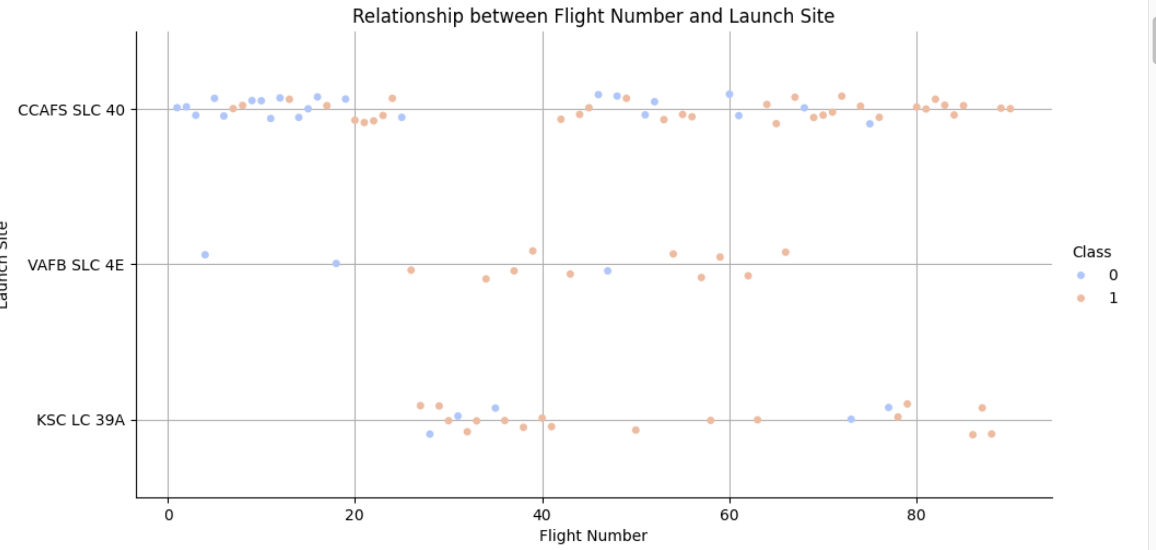
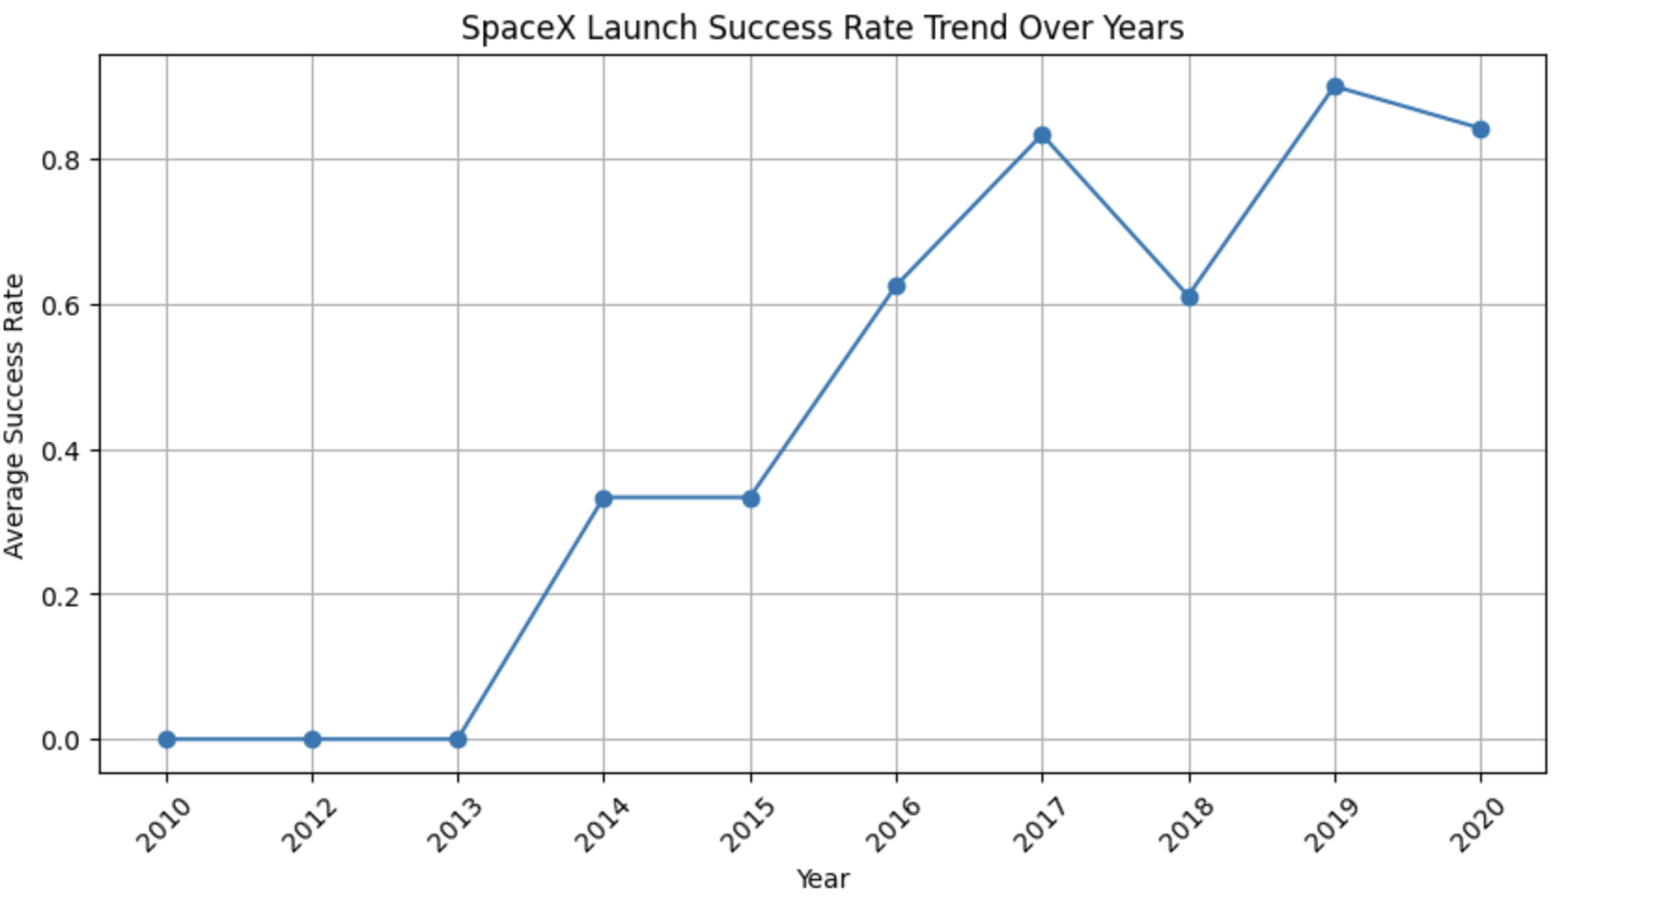

Slide 9
EDA with SQL Results
1
Total Launches per Site
2
Average Payload Mass
3
Frequent Customers
SQL queries were used to extract valuable insights from the SpaceX launch data, including the total number of launches per site, the average payload mass of successful missions, and the most frequent customers utilizing SpaceX services. Results revealed that KSC LC-39A had the highest launch frequency, specific orbits exhibited higher success rates, and there was a noticeable increase in successful landings over time. These findings contribute to a deeper understanding of operational efficiencies and key performance indicators.

Slide 10



Interactive Map with Folium Results
Success vs. Failure
2
Color-coded markers indicating success vs. failure.
Launch Sites
1
Displayed all SpaceX launch sites on an interactive Folium map.
Active Locations
3
Insights into the most active launch locations.
The integration of Folium allowed for the creation of an interactive geospatial map displaying all SpaceX launch sites. Color-coded markers were used to differentiate between successful and failed missions, offering immediate visual insights into site-specific performance. The map provided valuable insights into the most active launch locations and their corresponding success rates, enhancing our understanding of the geographical factors influencing mission outcomes.

Slide 11
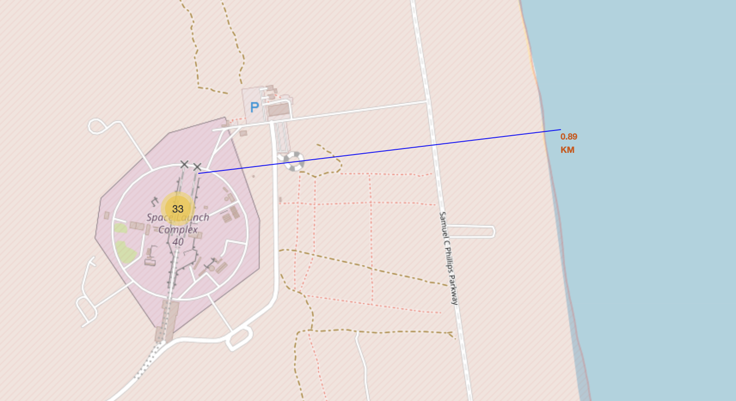
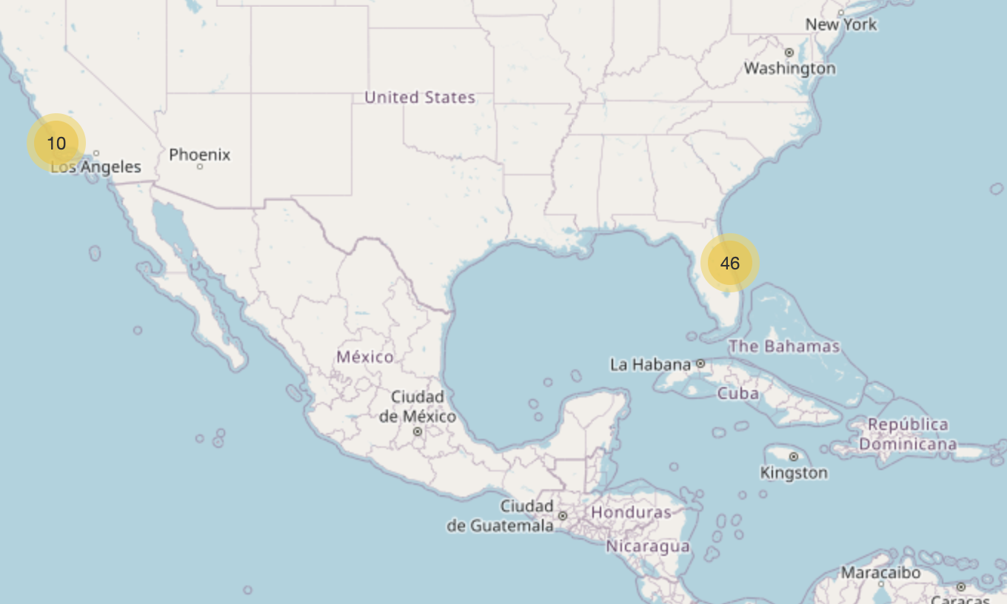
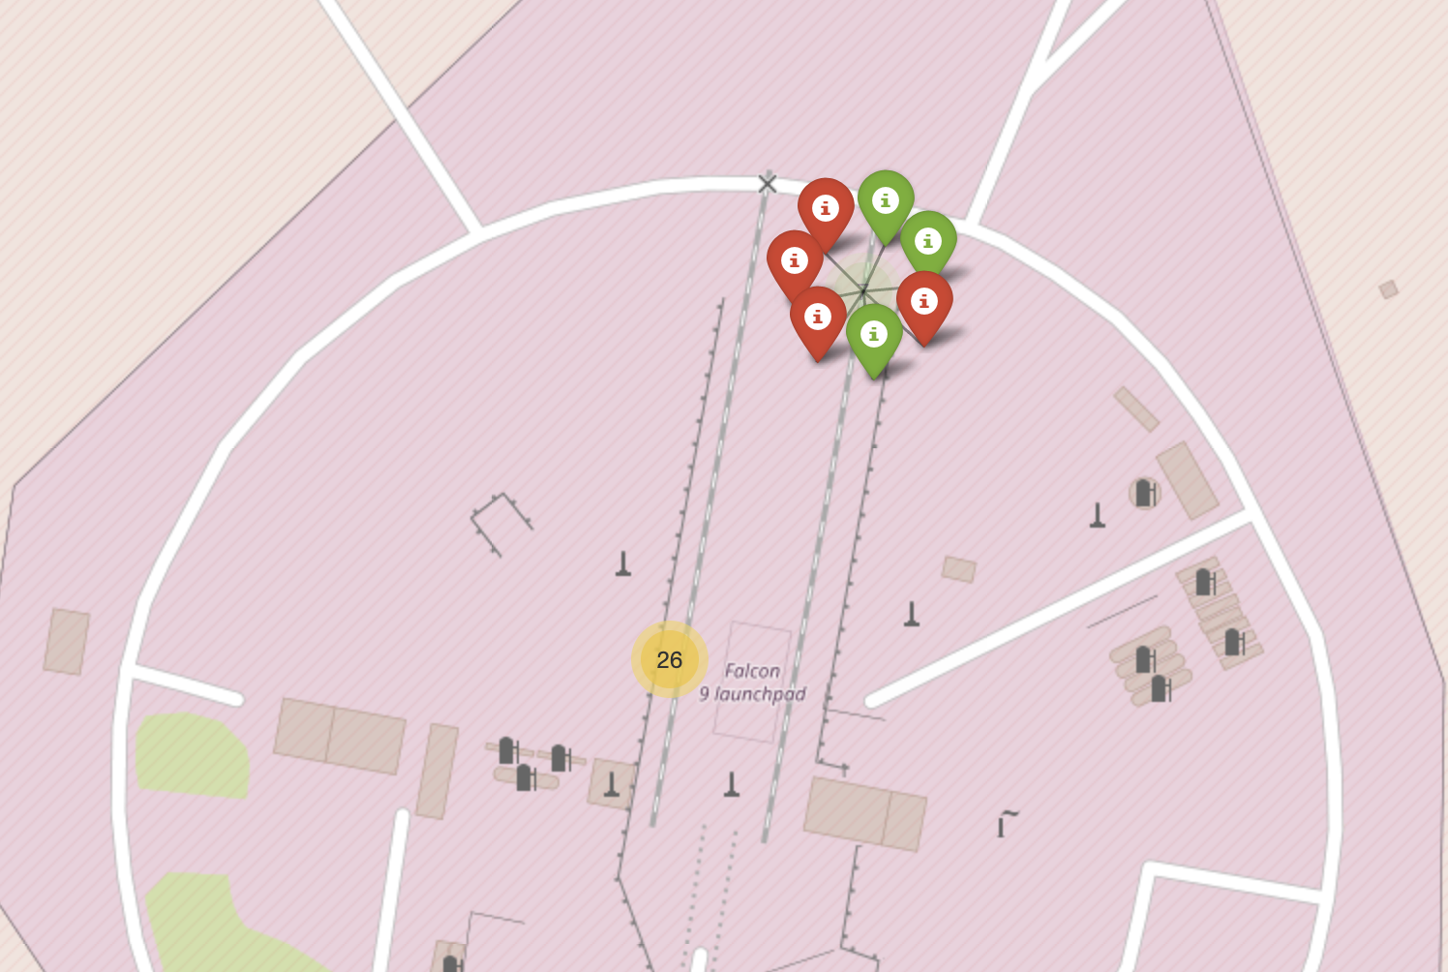
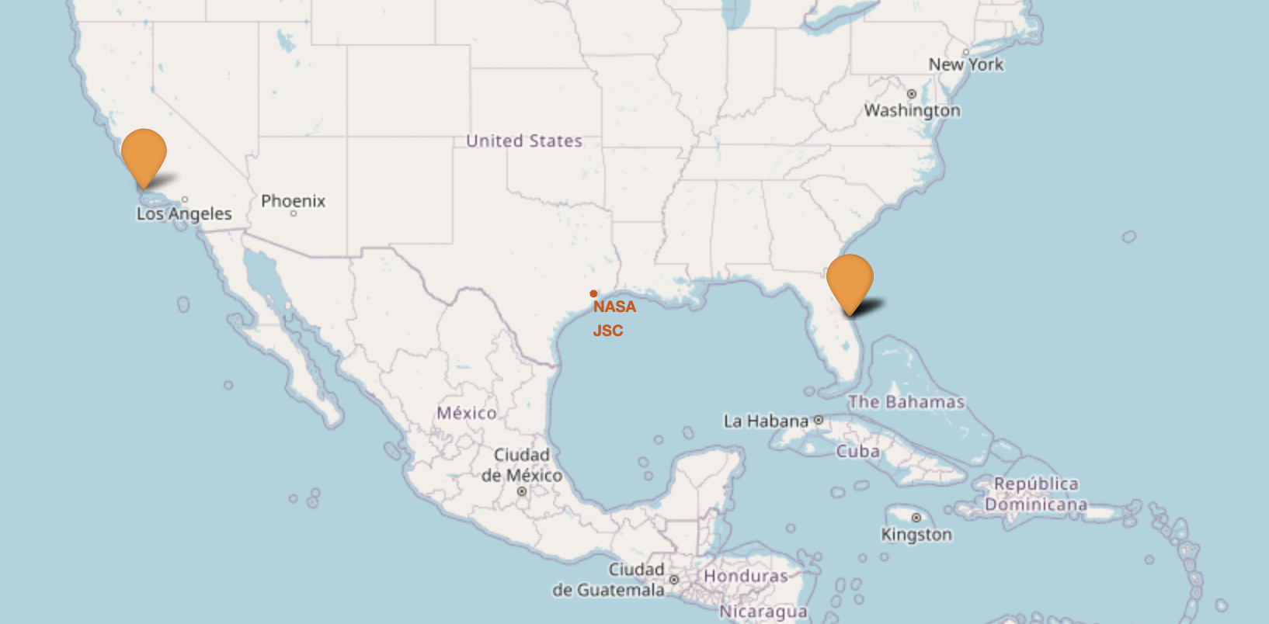

Slide 12
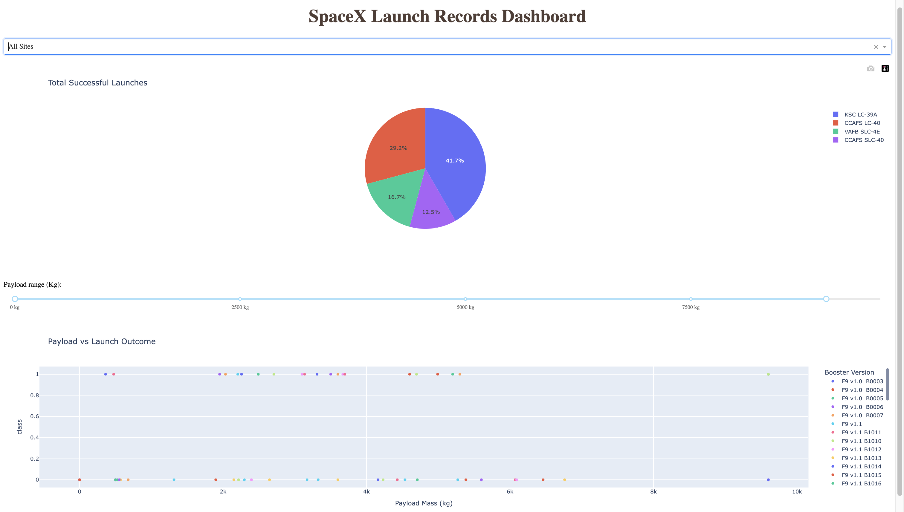
Plotly Dash Dashboard Results
Dashboard Features
Insights Gained
Dropdown filter for launch sites. Pie chart for total successful launches. Scatter plot showing payload vs. success outcomes.
Launch site-wise success distribution. Payload mass affects landing success. Booster versions play a role in reusability.
The Plotly Dash dashboard provided a dynamic and interactive platform for exploring SpaceX launch data. Features included dropdown filters for launch sites, pie charts illustrating total successful launches, and scatter plots visualizing payload versus success outcomes. Insights gained from the dashboard revealed the launch site-wise success distribution, the influence of payload mass on landing success, and the role of booster versions in reusability, offering a comprehensive overview of key mission parameters and their impacts.

Slide 13
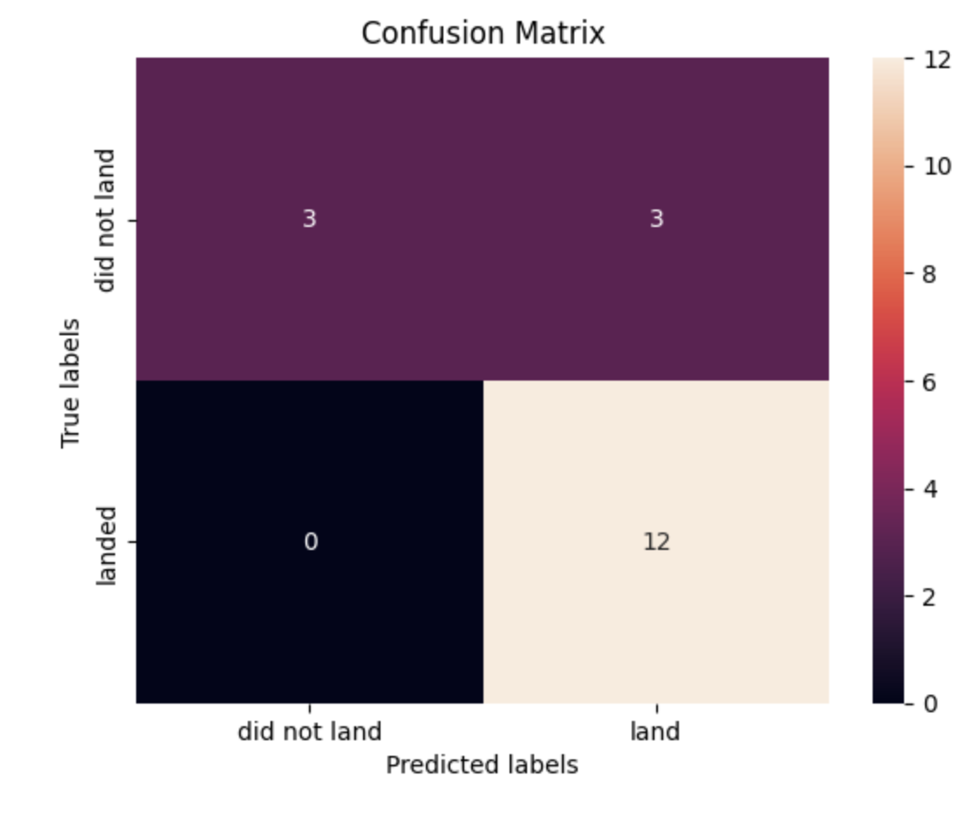
Model Performance Comparison
Decision Tree
Support Vector Machine
Logistic Regression
K-Nearest Neighbors
Achieved the highest test accuracy: 0.8893. Best-performing model with clear decision boundaries.
Test accuracy of 0.8464. Provides probability estimates for launch outcomes.
Test accuracy of 0.8482. Effective at handling complex data relationships.
Test accuracy of 0.8482. Performance is sensitive to hyperparameter tuning.
Confusion matric of Decision tree

Slide 14




CONCLUSION
Future Directions
Enhance Model Accuracy
Explore advanced machine learning algorithms. Fine-tune parameters for optimal performance.
Expand Dataset
Incorporate real-time data streams. Increase data volume for improved generalization.
Deep Learning
Investigate deep learning architectures. Apply neural networks to predictive modeling.

Slide 15
KEY TAKEAWAYS
Data-driven insights
into SpaceX launch trends.
Predictive modeling can
assist future mission planning.
Interactive dashboards provide
clear visualization for decision-making.
THANK YOU

